Slide 1
Eviction Data in LV
SeongJae Nam

Slide 2
Introduction of data
Using Las Vegas Eviction Data
Meaning of Eviction -> The action of expelling someone, especially a tenant, from a property
Features in data

Slide 3
First Task
Which geographical areas (e.g. zip codes or census tracts) see the highest eviction density each year and over time?
Are certain landlords filing a disproportionate number of eviction cases?
Are individual tenants evicted multiple times yearly?

Slide 4
Which geographical areas (e.g. zip codes or census tracts) see the highest eviction density each year and over time?
Zip code of 89119 see the highest eviction density both each year and over time.
But as you can see in the pie chart on next page, other zip code is almost same with 89119
89119, 89121 , 89169, 89115 are the most common zip code every year.

Slide 5
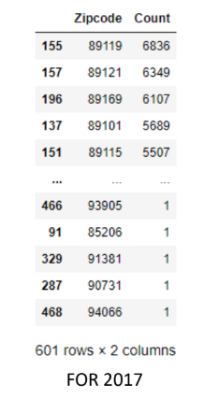
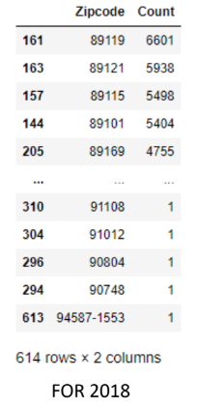
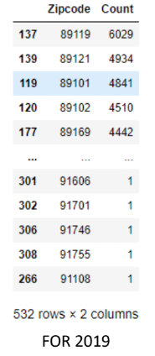
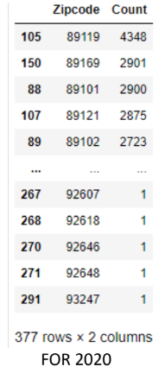
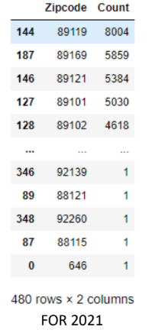
Which geographical areas (e.g. zip codes or census tracts) see the highest eviction density each year and over time?

Slide 6
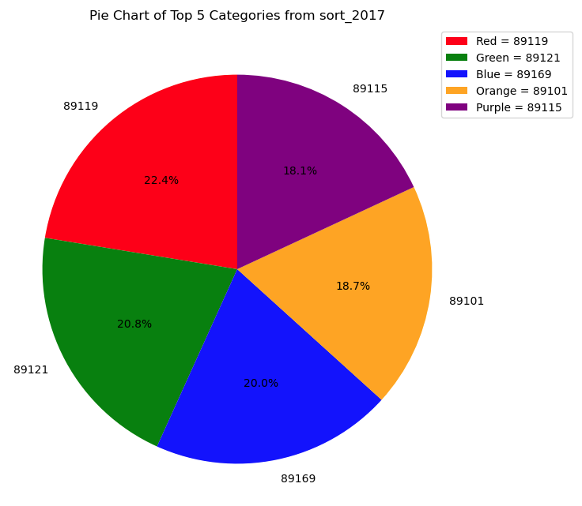
For 2017

Slide 7
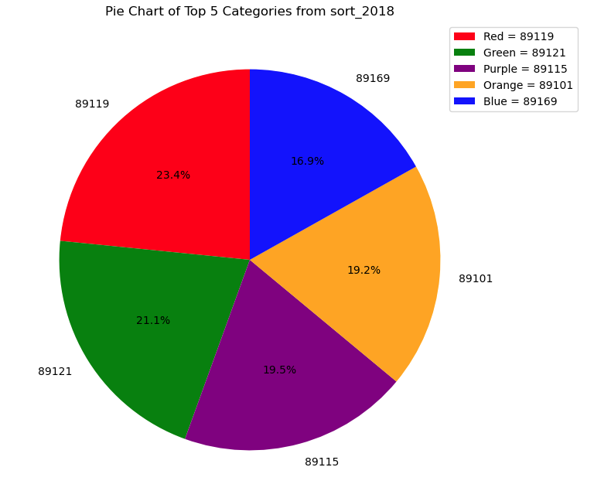
For 2018

Slide 8
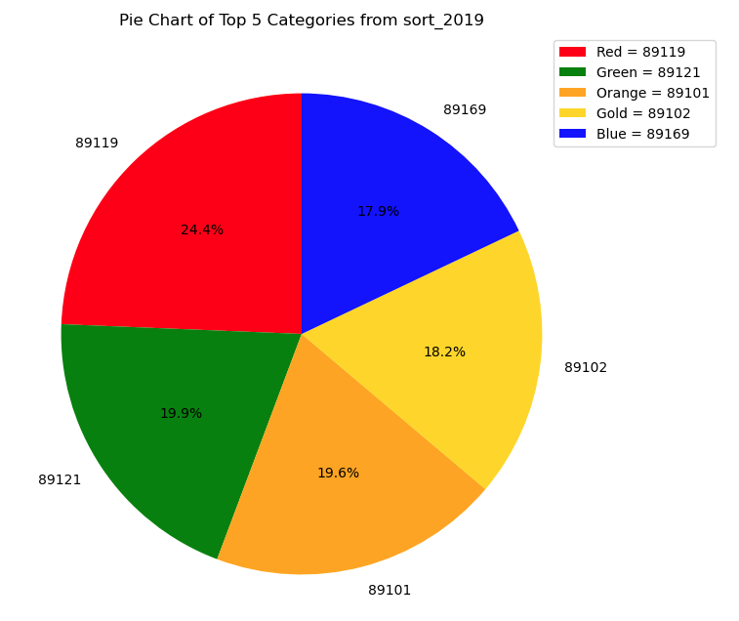
For 2019

Slide 9
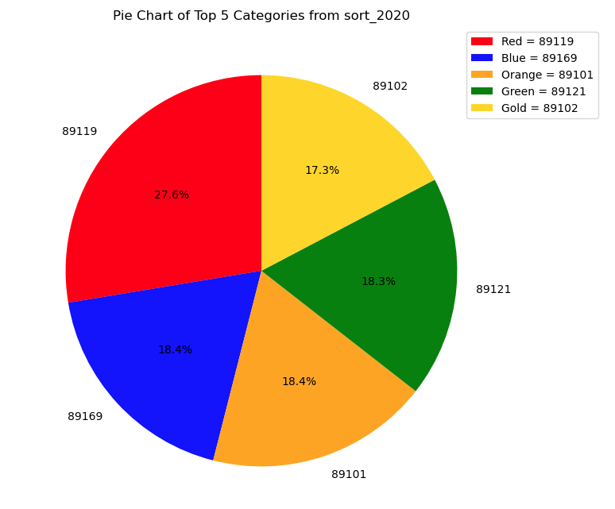
For 2020

Slide 10
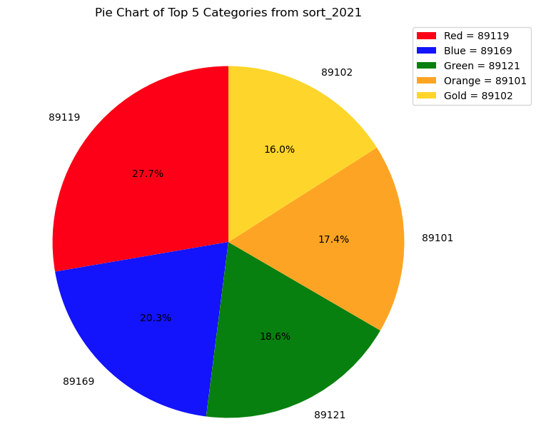
For 2021

Slide 11
2. Are certain landlords filing a disproportionate number of eviction cases?
Stout Management and Stout Management Company are filing a disproportionate number of eviction case
But I think they are company not individual landlord.
For Resolution Type, Summary Judgment is the most common case, but others are very rare
Majority of Zip Code are 89XXX, so region where Las Vegas, Nevada is common

Slide 12
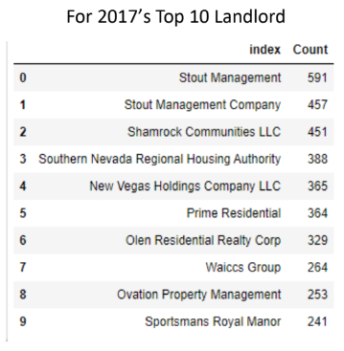
2. Are certain landlords filing a disproportionate number of eviction cases?
1. I am going to see about Stout Management & Stout
Management Company.

Slide 13
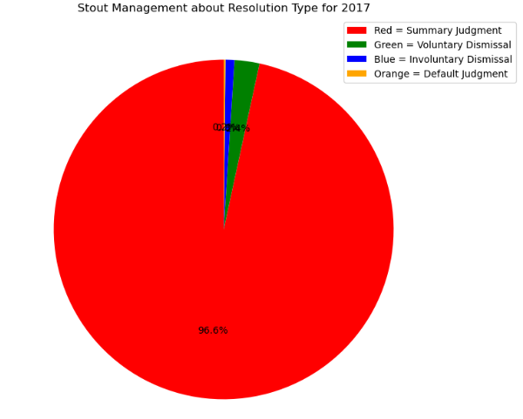
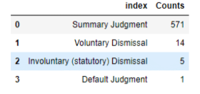
About Stout Management in 2017
Eviction filing type has only one type which is Summary Eviction
In Resolution Type, Summary Judgment is majority

Slide 14
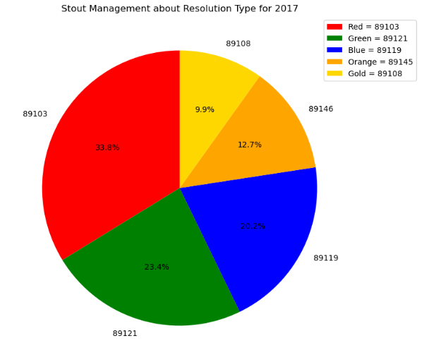
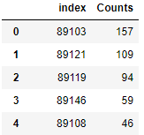
About Stout Management in 2017
In Zip Code, 89103, 89121, 89119 are majority

Slide 15
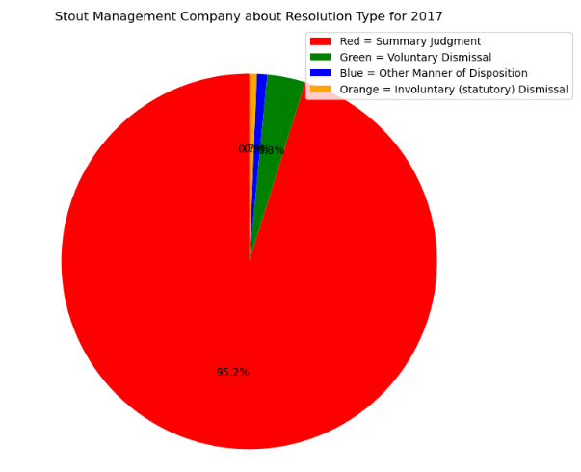
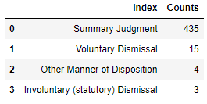
About Stout Management Company in 2017
Eviction filing type has only one type which is Summary Eviction
In Resolution Type, Summary Judgment is majority

Slide 16
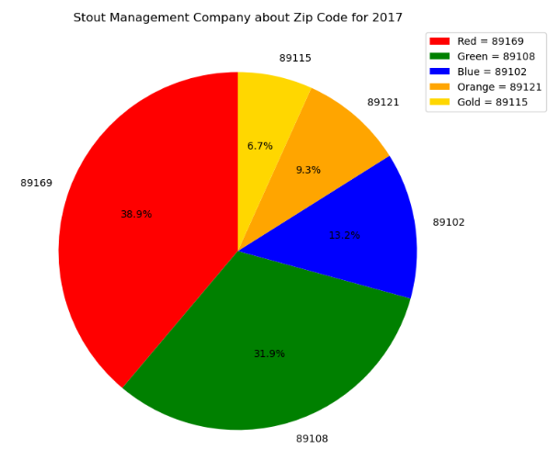
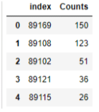
About Stout Management Company in 2017
In Zip Code, 89169, 89108, 89102 are majority

Slide 17
++ Problem of this data
When the address is same but notation is different, they are processed as separated data
There are some data which tenant’s City is not Las Vegas for example Texas, LA etc
Data is not clean - Las Vegas, LAS VEGAS, Las veas something like this
-> This problem is very serious
We have to clean this data!

Slide 18
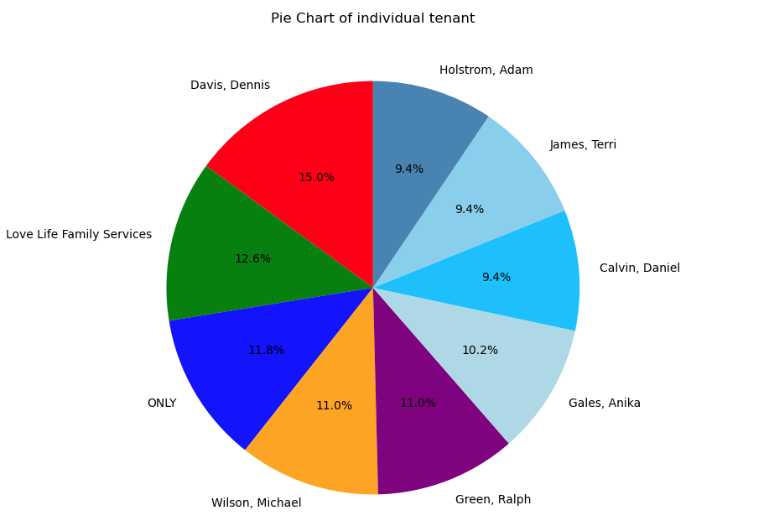
3. Are individual tenants evicted multiple times yearly and over time?
I can say evictions are evenly distributed across individuals! ( I checked 20 people, and they are almost same )

Slide 19
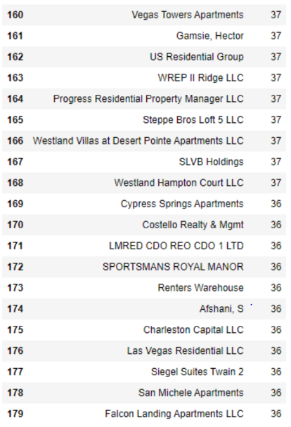
4. Find some information not company but individual
I tried to find individual not company among Landlord, but the highest ranking of individual is 164, and next one is 174
Is it important? I think it is not good information because most of data is about company

Slide 20
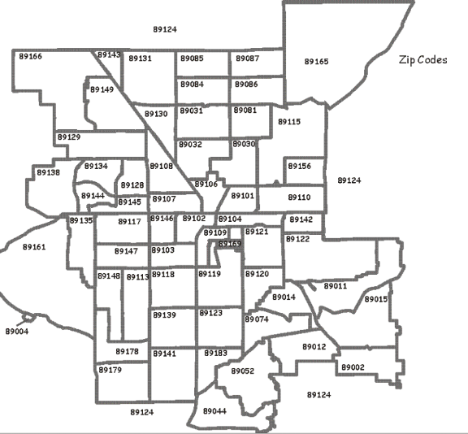
5. Distinguish by shading or circle, check mark according to the frequency of occurrence per Zip Code
At first, I tried to download image of Las Vegas Zip code map.
But it is hard to treat image data.
I decided to bring in map data using Folium ( Panda library)
And merge map data and Zip Code data ( I create by my self )

Slide 21
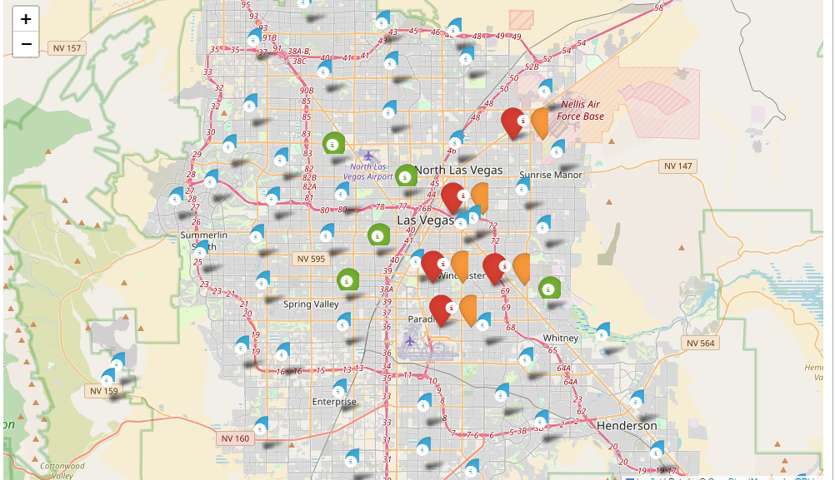


Slide 22
Future work
Matching Landlord and tenant which have same case number
Check certain Landlord and tenant do eviction year by year ( What information I can find? )
Data cleaning ( It is really hard to do )

